Slide 1
Selenium Course Session 2

Slide 2
Tricks/Shortcut Keys:
Eclipse
Ctrl + Shift + F - Alignment
Ctrl + Shift + O - Import library
Ctrl + Space bar - Suggestion / Auto Complete
Ctrl + Alt + Down Arrow key - To create a Duplicate the row
Alt + Left Arrow key - To navigate back
Alt + Right Arrow key - To navigate forward
Chrome Browser
Ctrl + Shift + I - Inspect
Ctrl + Shift + C - Select Element Locator
Ctrl + F - Search box

Slide 3
Waits..
Waites in Selenium
Implicit Wait
Explicit Wait
Driver.manage(). Timeout().
Thread.sleep()
WebDriverWait

Slide 4
Implicit vs Explicit Waits
Implicit:
Driver.manage().timeouts().implicitlyWait(20, TimeUnit.Seconds);
Explicit:
WebDriverWait wait = new WebDriverWait(driver, 60);
wait.until(ExpectedConditions.visibilityof(driver.findElement(By.name(" "))));
Implicit | Explicit
Implicit wait time is applied to all the elements in the script | Explicit wait time is applied only to those elements where the user specifies the “ExpectedConditions”
It is recommended to use when the elements are located with the time frame specified in implicit wait | It is recommended to use when verifying the property of the element like (visibilityOfElementLocated, elementToBeClickable, elementToBeSelected)
Executes on remote side (browser side) | Applies on local side

Slide 5
Element Locator
Locator is a command that tells Selenium IDE which GUI elements (Text Box, Buttons, Check Box etc.) its needs to operate on.
Types of Locators:
ID - Attribute
Name - Attribute
ClassName - Attribute
Link Text - Hyperlink
Partial Link Text - Part of the Hyperlink
CSS Selectors - Style
XPath - XML Language

Slide 6
HTML DOM Nodes
Attribute
Node
Value
Hyperlink
Element Node / Tag Name
Text
Link: http://objectspy.space/

Slide 7
CSS Selector
Features:
Faster way to locate element
Use any attribute to locate element
Use multiple attribute to locate element
Syntax:
TagName#Value Note: (#) represents ID
TagName.Value Note: (.) represents CLASS
TagName[attribute = ‘value’]
TagName.class[attribute = ‘value’]

Slide 8
XPath..
XPath stands for XML Path Language
It can be used to navigate through elements and attributes in an XML/HTML document
It uses path expressions to select nodes in an XML document

Slide 9
Basic Selecting Nodes
Expression | Description
/ | Selects form the ROOT node
// | Selects nodes in the document from the current node
@ | Selects attributes
* | Matches any element node
@* | Matches any attribute node
Location Path:
2 types of Location Paths
Absolute – starts with a slash (/)
Relative – Starts with a double slash (//)

Slide 10
Xpath Example
Syntax:
//Tag[@Attribute Node=‘Value’]
Example: //input[@id=‘username’]
//Tag[@ Attribute Node =‘Value’ and @ Attribute Node =‘Value’ ]
Example: //input[@type=‘submit’ and @value=‘login’]
Xpath for links:
//Tag[text()=‘Value’] or //Tag[contains(text(), ‘Value’)]
Example: //input[text()=‘new page’] or //input[contains(text(), ‘new page’)]

Slide 11
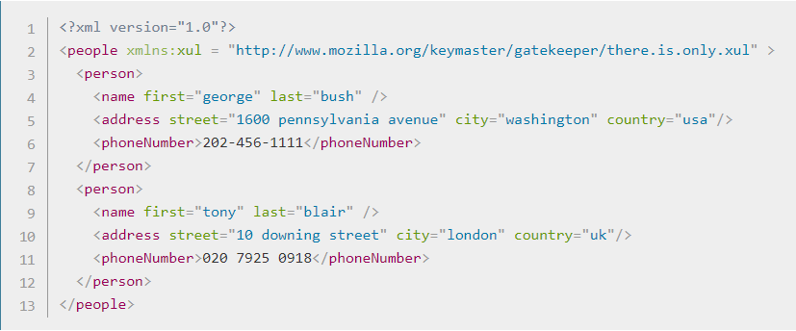
Xpath Axes..
Relationship of Nodes:
Parent
Children
Siblings
Ancestors
Descendants

Slide 12
Homework
Automate the following test case:
Scenario: Users will be able to add deposit
1: Open Browser and go to site http://www.techfios.com/billing/?ng=admin/
2. Enter username: demo@techfios.com
3. Enter password: abc123
4. Click login button
5. Click on Transactions button
6. Click on New Deposit button
7. Click on Open An Account drop down to expand it
8. Click on any account name
9. Type any description
10. Type any amount
11. Click on submit button
Visually check to make sure the deposit posted

Slide 13
Interview Questions
Name some of Element Locators
Difference between Implicit Wait and Explicit Wait
What is the difference between absolute xpath and relative xpath?
Which XPath do you use?
Which element locator is faster to identify?
If the element is a link, which locator should you use?
Explain the difference between driver.close vs driver.quit
What JUnit annotation is used to run a test?
What Selenium method is used to type something in a text box?

